Slide 1
Lecture 13
Conditional Expectation and Variance
Bivariate Normal Distribution

Slide 2
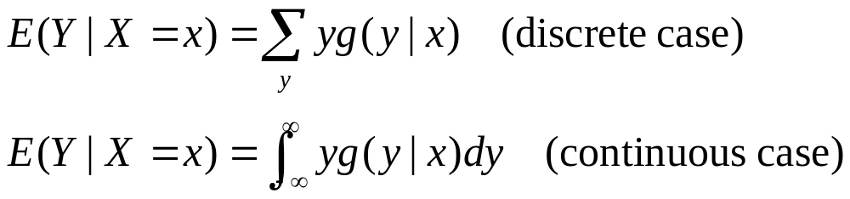
Conditional Expectation
Suppose X and Y are random variables with joint p.f. or p.d.f. f(x,y), let f1(x) denote the marginal p.f. or p.d.f. or X, for any value of x such that f1(x)>0, let g(y|x) denote the conditional p.f. or p.d.f. of Y given X=x.
The conditional expectation of Y given X , denoted by E(Y|X), is specified as a function of X:

Slide 3
The Conditional Expectation
Is a Random Variable
E(Y|X) is a function of the random variable X, so it is itself a random variable with its own distribution.
The distribution of E(Y|X) can be derived from the distribution of X.
We can find the mean and the variance of E(Y|X).

Slide 4
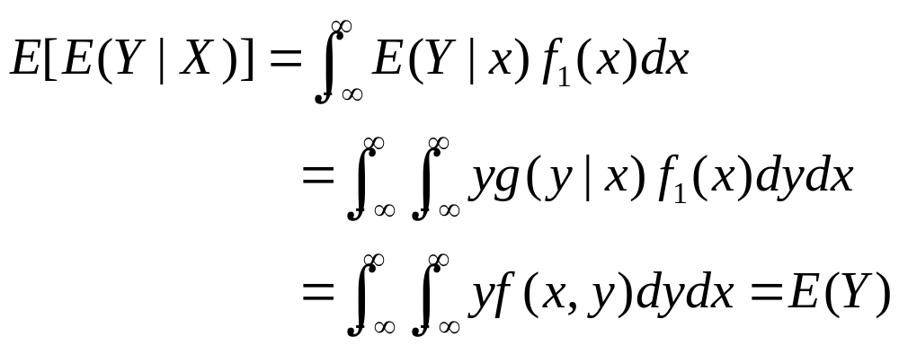
Theorem. For any random variables X and Y, E[E(Y|X)]=E(Y).
Proof. Assume for convenience that X and Y have a continuous joint distribution, then

Slide 5
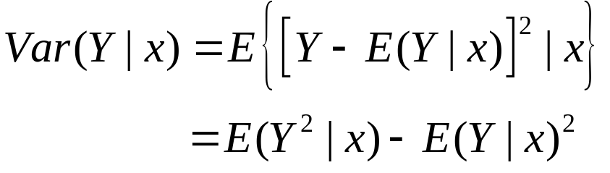
Conditional Variance
Let Var(Y|x) denote the variance of the conditional distribution of Y given X=x, i.e.,

Slide 6
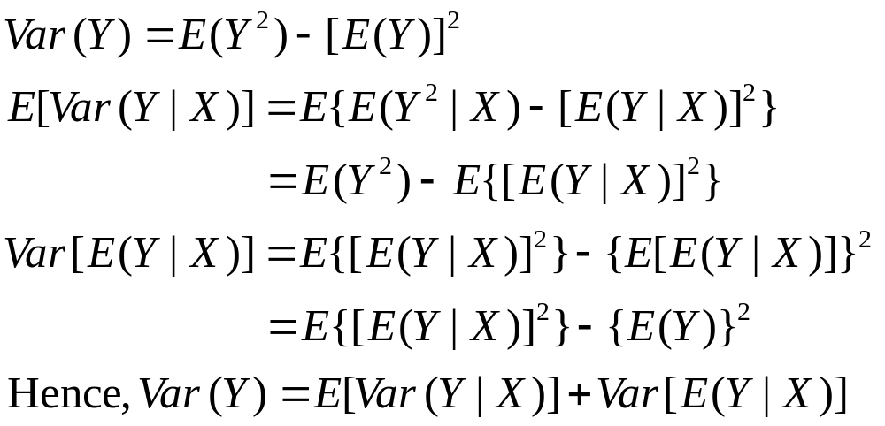
Variance and Conditional Variance
Eve’s Law
Proof.

Slide 7
Example. Customers with Coupons
Suppose that the number of customers coming to certain McDonald store in a day follows a Poisson distribution with parameter λ.
Suppose that each customer independently presents a coupon with probability p (and no coupon with probability q=1-p).
What are the expectation and variance of the number of customers using coupons in a day?

Slide 8
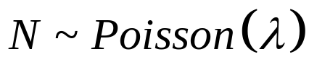
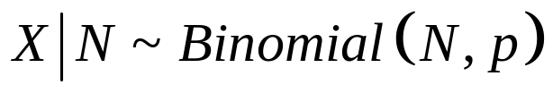
Solution. Customers with Coupons
Let N denote the number of customers in a day.
Let X denote the number of customers using coupons in a day.

Slide 9
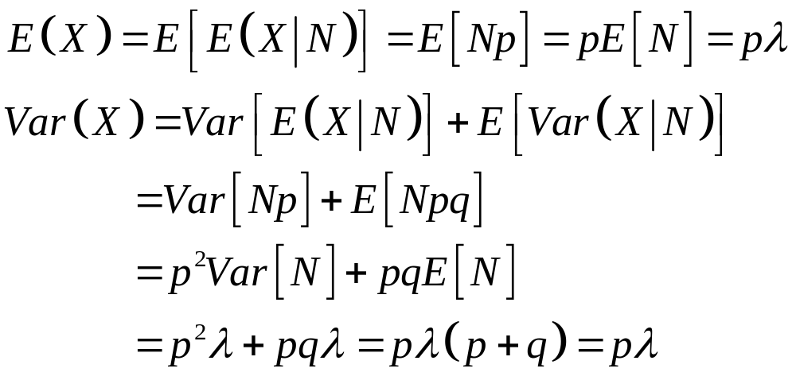
Solution. Customers with Coupons

Slide 10
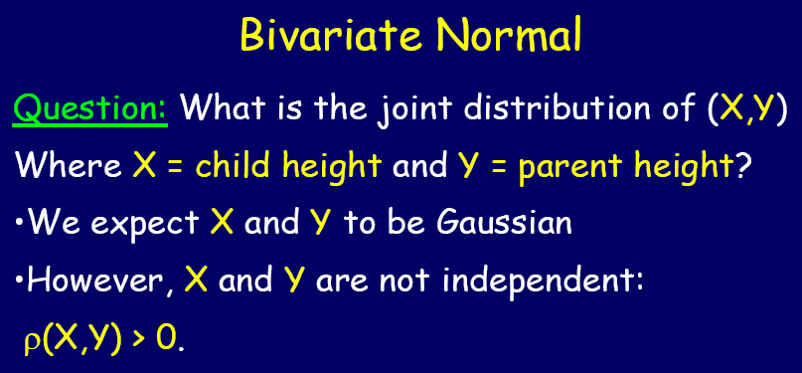

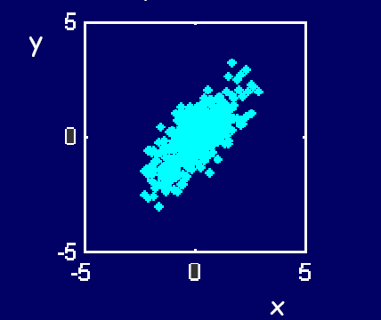

Slide 11

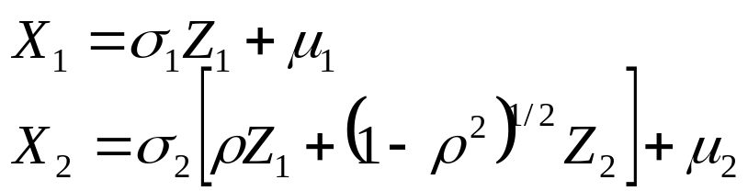
The Bivariate Normal Distribution
Suppose that Z1 and Z2 are independent random variables, each of which has a standard normal distribution. For any constants such that
define X1 and X2 as follows:

Slide 12
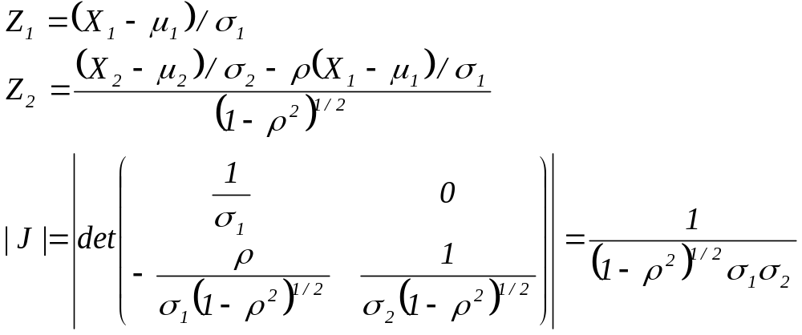

Slide 13
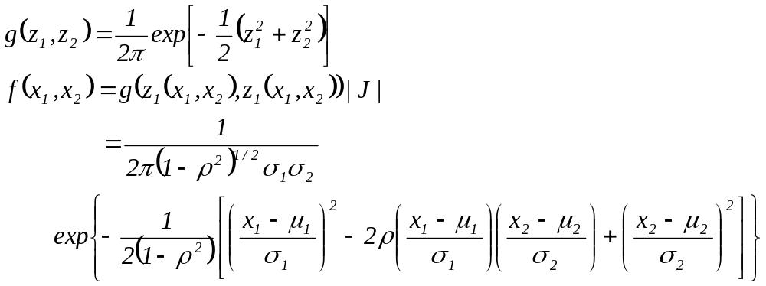

Slide 14
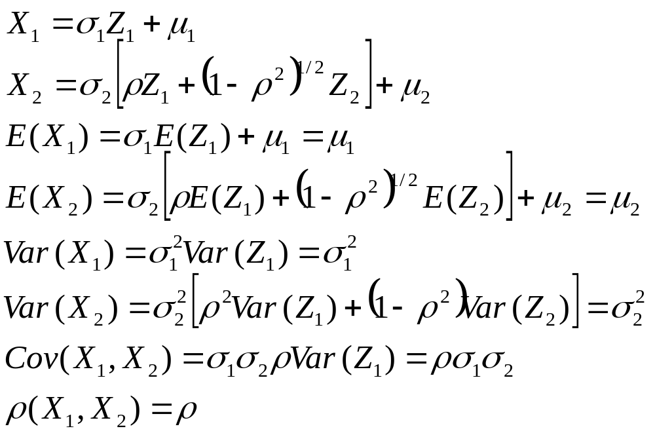
X1 and X2 are said to have a bivariate normal distribution.

Slide 15
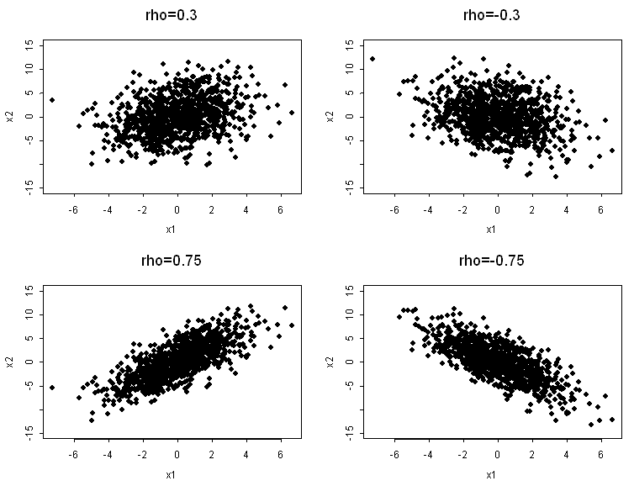

Slide 16


Marginal Distributions
Since both X1 and X2 are linear combinations of Z1 and Z2, the marginal distribution of both X1 and X2 are normal distributions. So the marginal distribution of Xi is a normal distribution with mean and variance .

Slide 17

Independence and Correlation
If , then X1 and X2 are uncorrelated. The joint p.d.f. can be factored into the marginal p.d.f. of X1 and the marginal distribution of X2. Hence X1 and X2 are independent.
Two random variables X1 and X2 that have a bivariate normal distribution are independent if and only if they are uncorrelated.

Slide 18


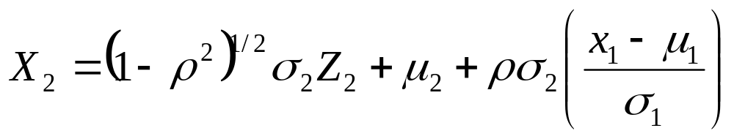
Conditional Distributions
  If X1=x1, then . The conditional distribution of X2=x2 is the same as the conditional distribution of

Slide 19
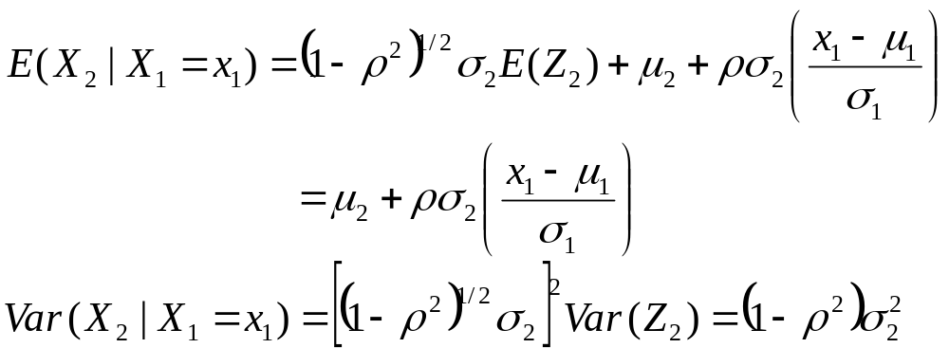
  Because Z2 is independent of X1, the conditional distribution of Z2 given X1 is the marginal distribution of Z2 ---a standard normal distribution.
  So the conditional distribution of X2 given X1 =x1 is a normal distribution with mean and variance:

Slide 20
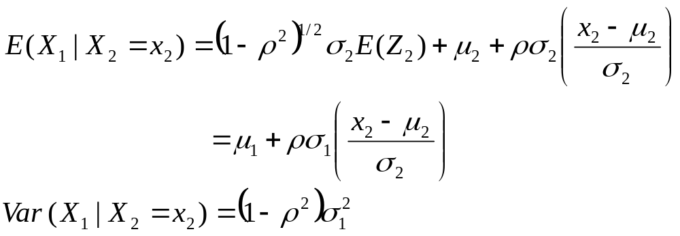
  Similarly, the conditional distribution of X1 given X2 =x2 is a normal distribution with mean and variance:

Slide 21



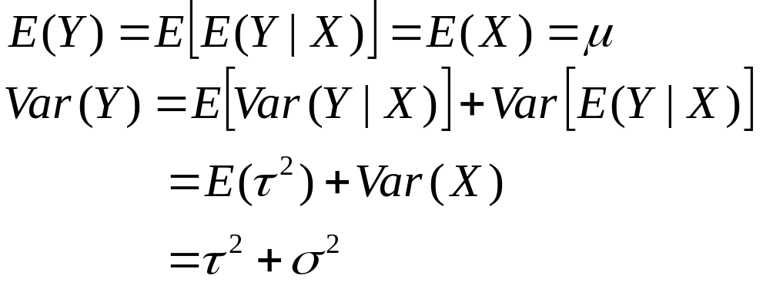
Example
Suppose X has a normal distribution with mean and variance . For any x, the conditional distribution of Y given X=x is a normal distribution with mean x and variance . What is the marginal distribution of Y?
  The joint distribution of X and Y can be derived as a bivariate normal distribution.
  The marginal distribution of Y must be a normal distribution.

Slide 22
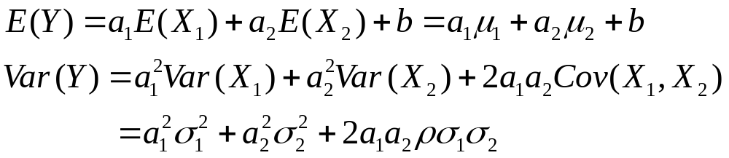
Linear Combinations
Suppose X1 and X2 have a bivariate normal distribution. Consider Y=a1X1+a2X2+b, where a1, a2 and b are arbitrary given constants.
  Both X1 and X2 can be represented as linear combinations of independent and normally distributed random variables Z1 and Z2, so Y can is also a linear combination of Z1 and Z2.
  So Y has a normal distribution.

Slide 23
Example 5.12.4
Suppose that a married couple is selected at random from some population. The joint distribution of the height of the wife and the height of her husband is a bivariate normal distribution with
What is the probability that the wife will be taller than her husband?

Slide 24
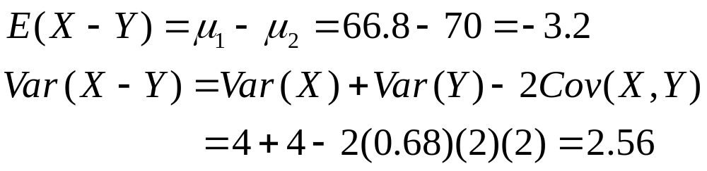

Let X denote the height of the wife, and let Y denote the height of her husband.
The distribution of X-Y will be normal with
So has a standard normal distribution.

